Slide 1

Pension management system
By: SAIBHAVANA AAKULA
emp id:2175663​

Slide 2
contents
Introduction
Functionality
Implemented Methods
Architecture of Application(Spring-Boot Architecture)
Procedure
Dockerization
Steps of Dockerization
Requirements
Advantages
Conclusion

Slide 3

Introduction
The purpose of building this application is to build a system that gives employee or employer various functionality for their pension management system.
This application includes various function like create applicant , check status , check balance ,check application, issue pension ,load pension using spring boot framework.
This project is build as per Java Microservices Architecture with the help of spring-boot.

Slide 4

Functionality
Add Pensioner/Employee Records
View Employee Records
Search Records(by id)
Calculate Pension(by their status)

Slide 5
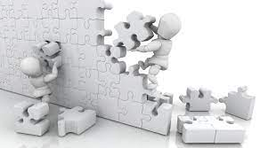
Implemented methods
Create Applicant
Check Status
Check Balance
Check Application
Issue Pension
Load Pension

Slide 6

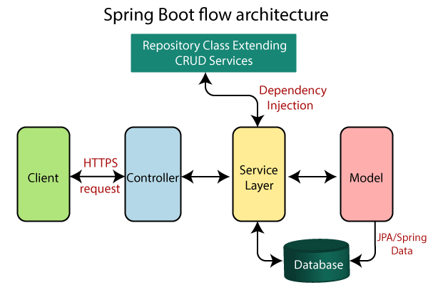
Architecture of application

Slide 7
Procedure
Project structure is created using Spring Initializer by adding all the required dependencies, plugins and versions.
Write required classes and methods.
We have to install all the dependencies by doing mvn clean install.
Start MySQL image in docker using docker-compose -f docker- compose-mysql.yml up -d
We have to run the application by using maven spring-boot: run. Tomcat Apache server will be started after running the project.
Work on the data in Postman by using URL https://localhost: port number/method name

Slide 8

dockerization
Docker is a software platform that allows you to build, test, and deploy applications quickly.
Docker packages software into standardized units called containers that have everything the software needs to run including libraries, system tools, code, and runtime.
Using Docker, you can quickly deploy and scale applications into any environment and know your code will run.

Slide 9
Steps of dockerization
To dockerization we need Docker file in our application.
After that start docker from docker desktop
Run command mvn install dockerfile:build
Check docker desktop weather image is created or not
Push to docker hub from docker desktop.

Slide 10
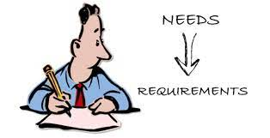
requirements
Software requirements:
Hardware requirements:
Java Spring-boot
MySQL
Maven
Docker
IDE(IntelliJ/Eclipse)
Windows OS
Internet connection

Slide 11

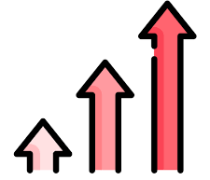
advantages
It is an User friendly application.
MySQL database helps to minimize data redundancy.
User can easily perform operations like add, update, search, delete the
data from database.

Slide 12

conclusion
This Pension Management System is designed to manage pension activities for both applicants and pension admins. It is good for organization as well as employee because it is easy to use. This project is all about the solution that will largely help eliminate the problems associated with the manual process and easy to manage pensions.

Slide 13



